Slide 1

Coder Dojo 10/1

Slide 2
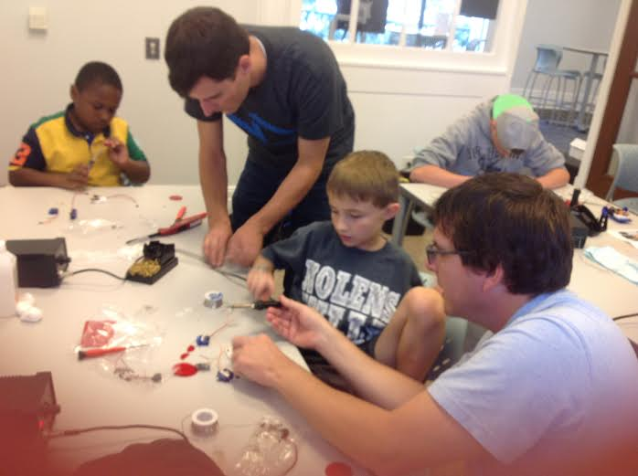
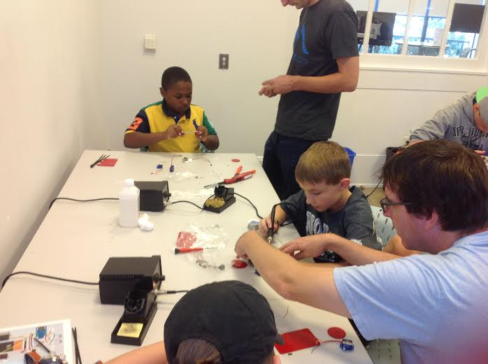
Learning about Bots
Visited Coder Dojo Nashville

Slide 3
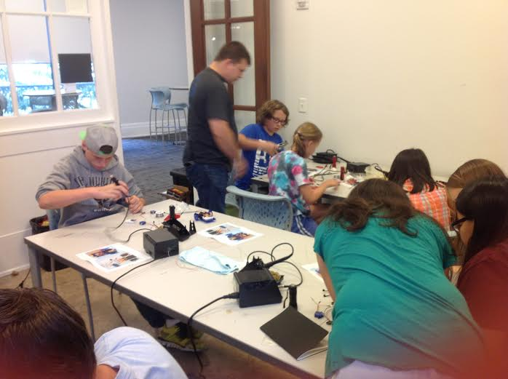
Nash Micro Donated their Time and Kits
Thanks Ian Lee and Patrick Becker
http://makezine.com/author/ian-lee/
Planning a workshop
during Christmas Break
More details later.

Slide 4
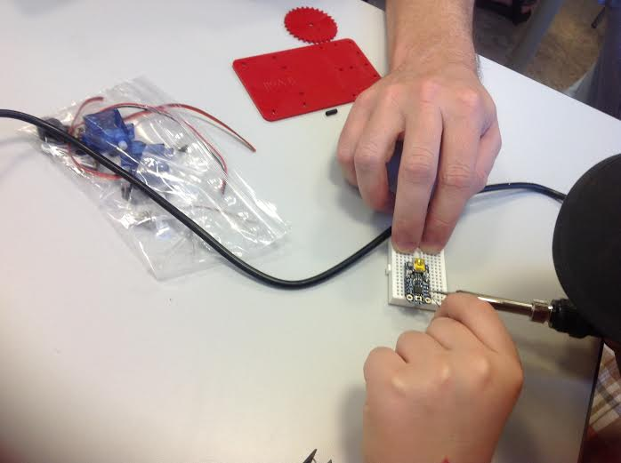
Learned About Bread Boards and Soldering
It takes practice but
you can fix mistakes.
The breadboard is
the framework.
This bot uses an Arduino as a processor

Slide 5
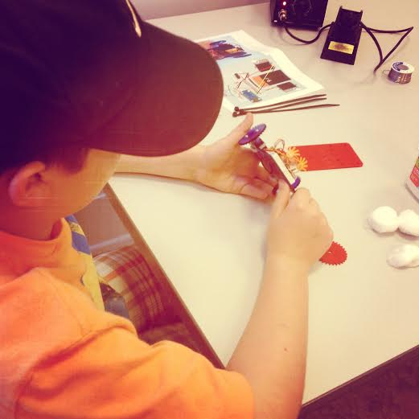
Finished Lumineater Bot
It loves the light
Learn more about
robotics in Nashville:
http://www.mtras.com/
http://makezine.com/magazine/creative-marketing-helps-nashmicro-buy-training-kits/
http://makezine.com/

Slide 6
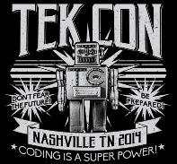
Fall Break Technology Workshop
October 10th at AGame Sports
9 am to 430pm
Learning, fun, prizes
http://www.tekcongrp.com/tekcon2014class

Slide 7
Snake with Javascript
Go to this link: http://jsfiddle.net/unsign3d/uq6YL/light/
Modify the code, change the color of the snake, change the speed. Use different keys. Build in a Easter Egg.
Go to google and find other JSFiddle examples.

